Slide 1
Predicate Logic M. Shahzad
Taken from: Imdad ullah

Slide 2
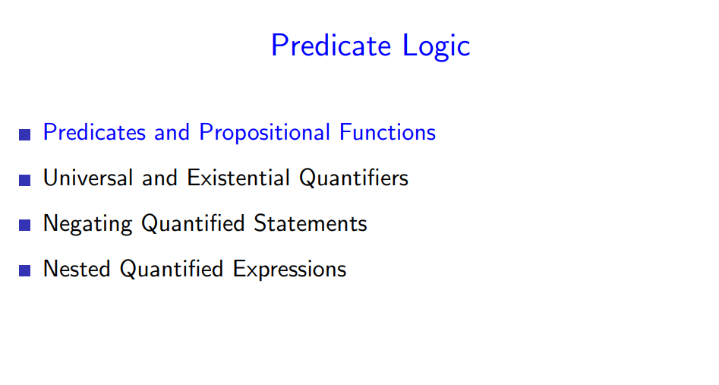

Slide 3
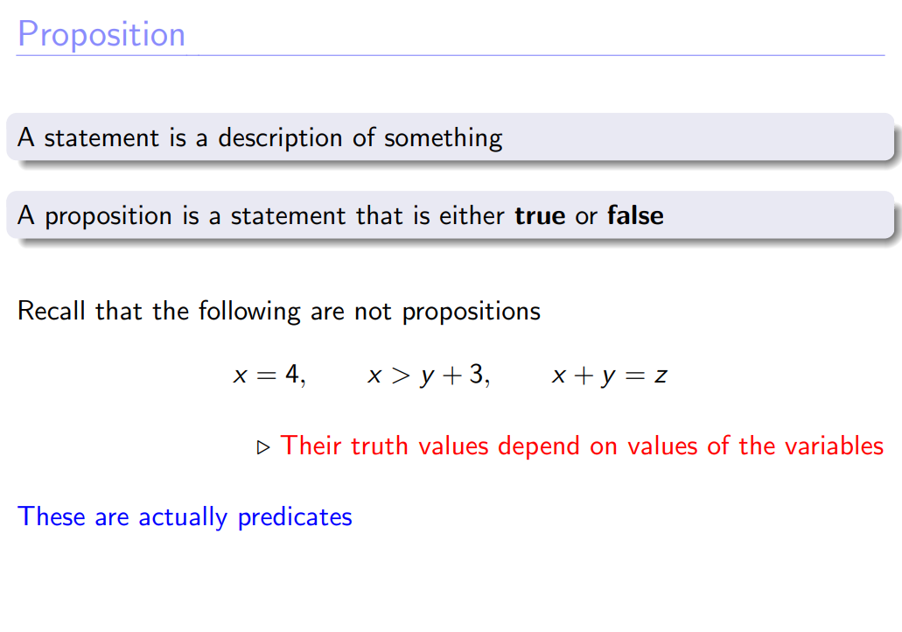

Slide 4
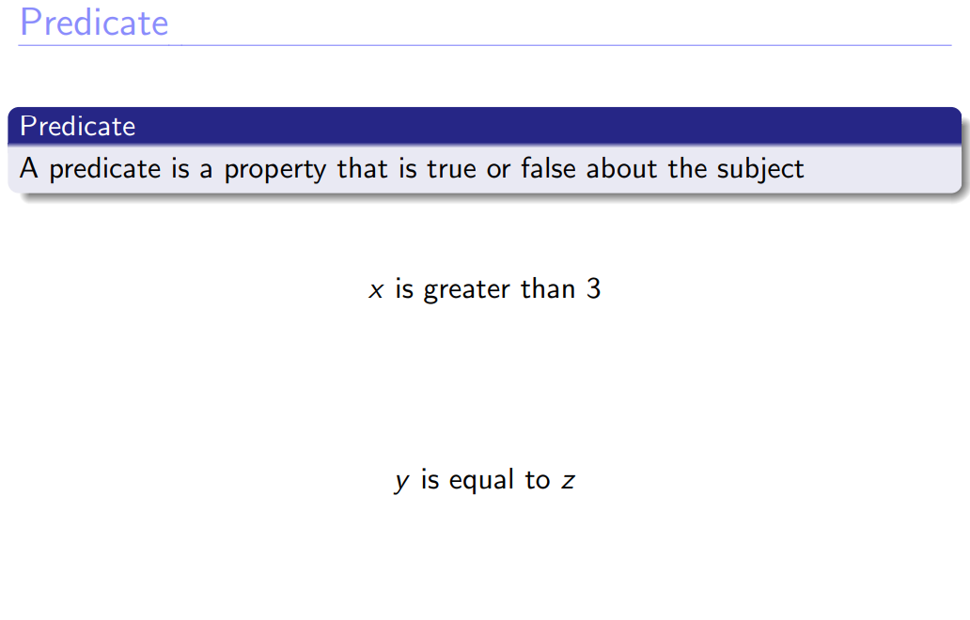

Slide 5
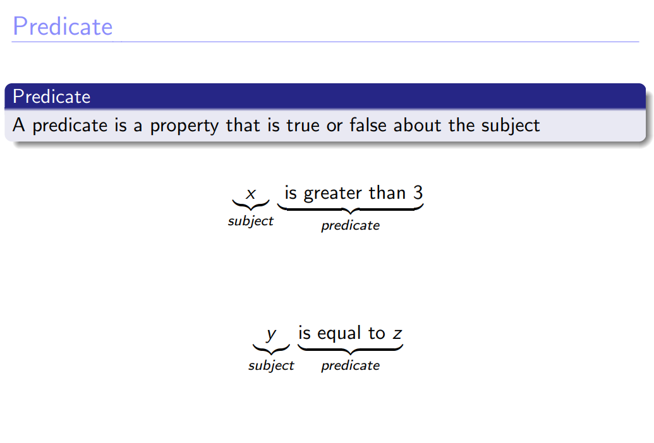

Slide 6
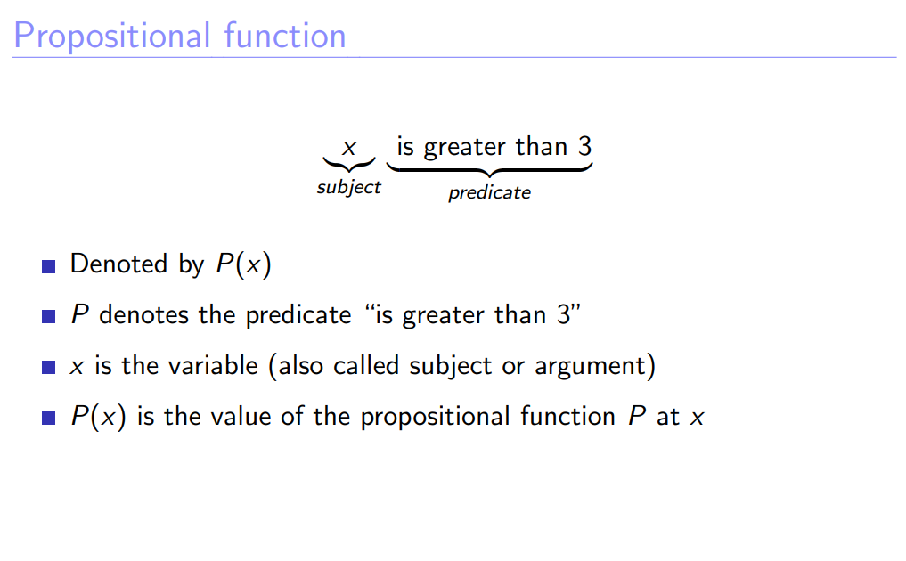

Slide 7
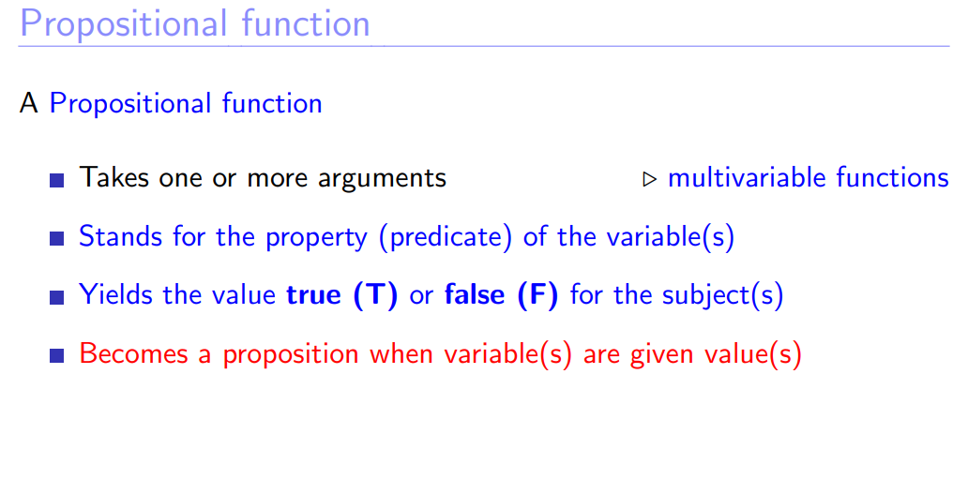

Slide 8
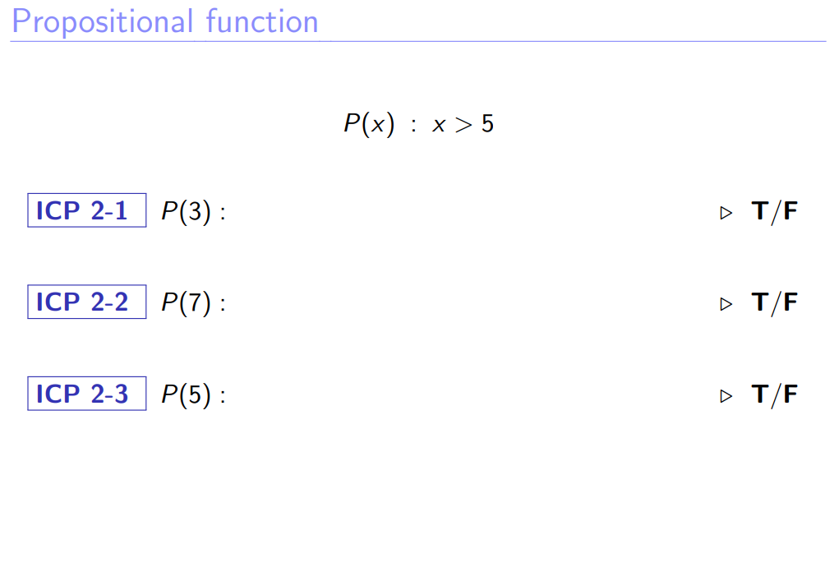

Slide 9
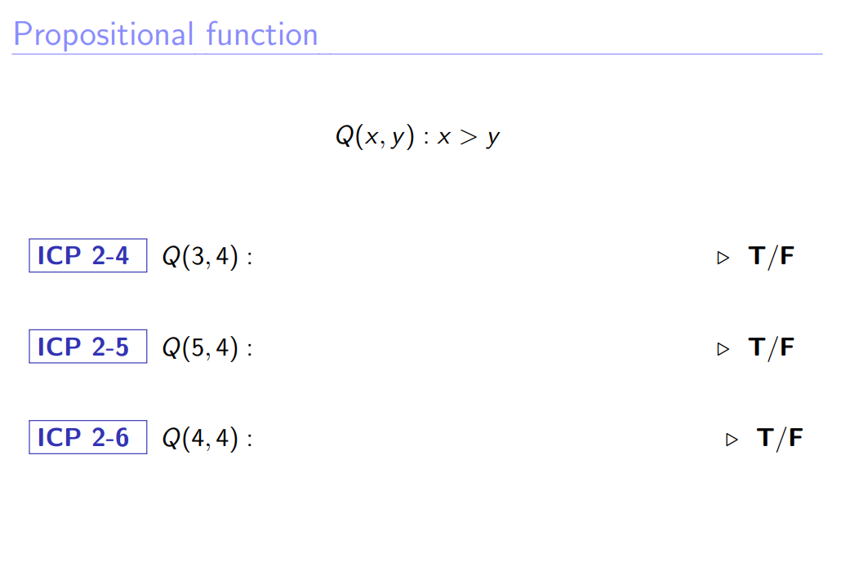

Slide 10
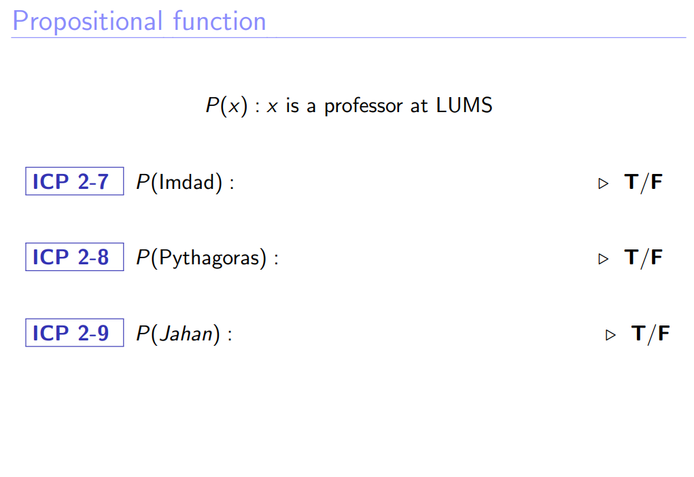

Slide 11
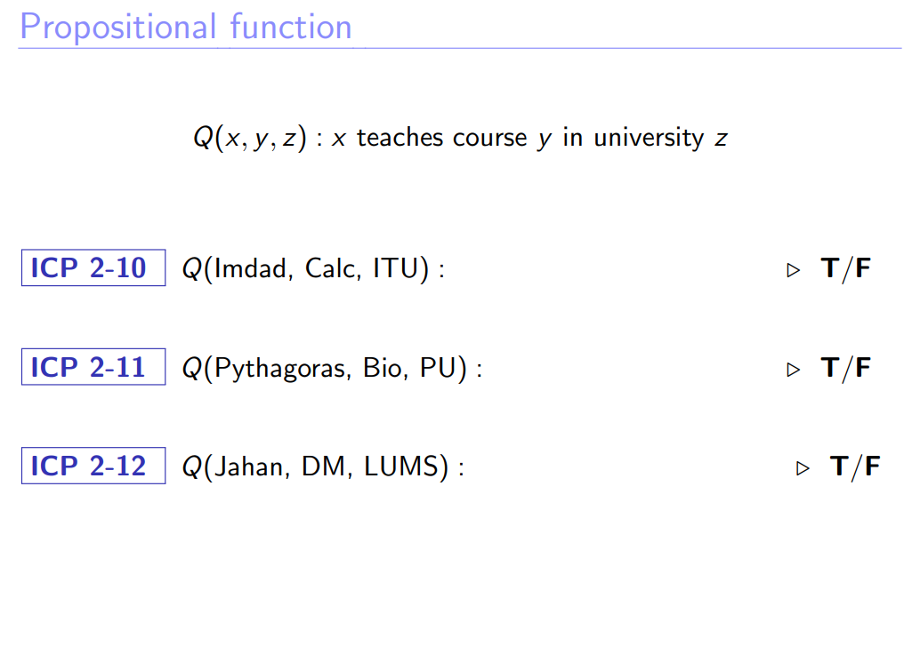

Slide 12
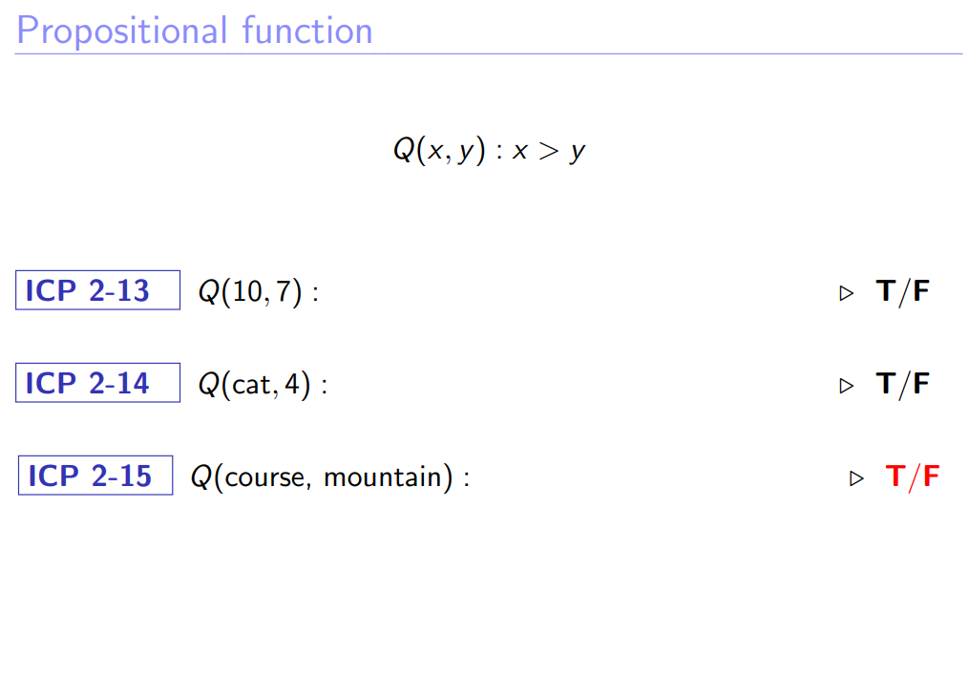

Slide 13
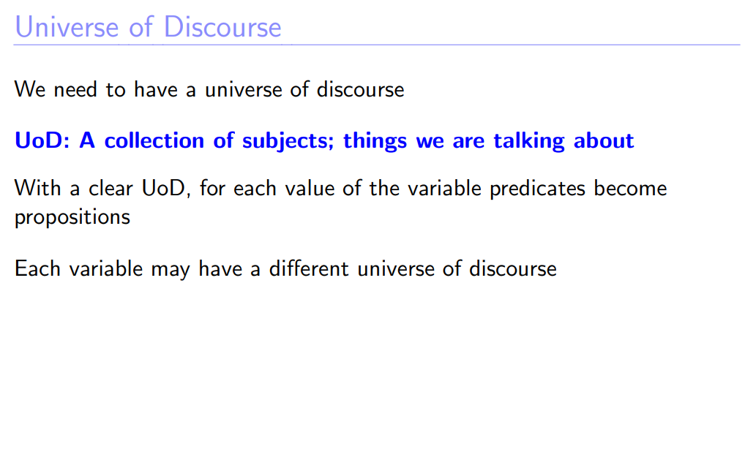

Slide 14
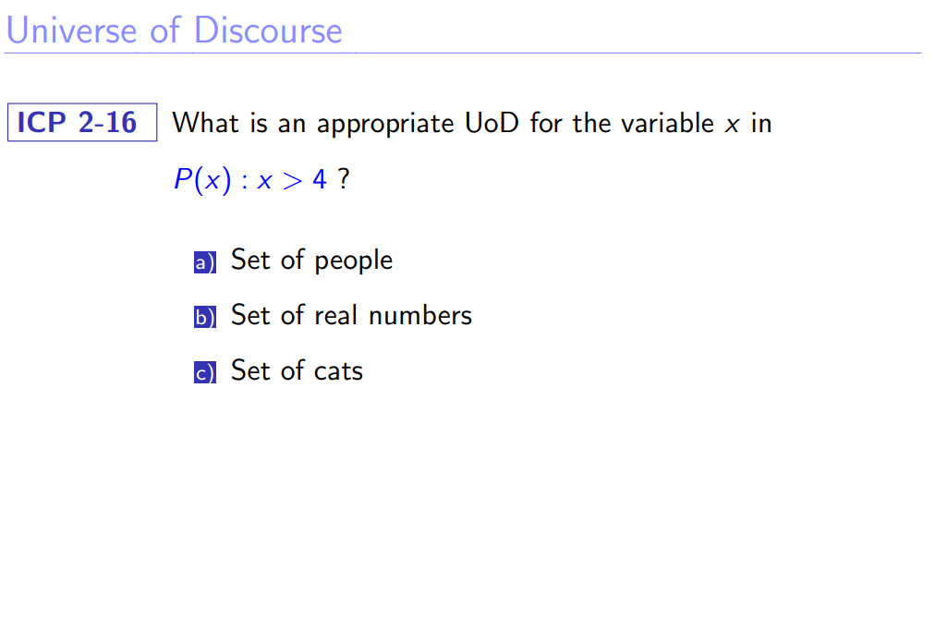

Slide 15
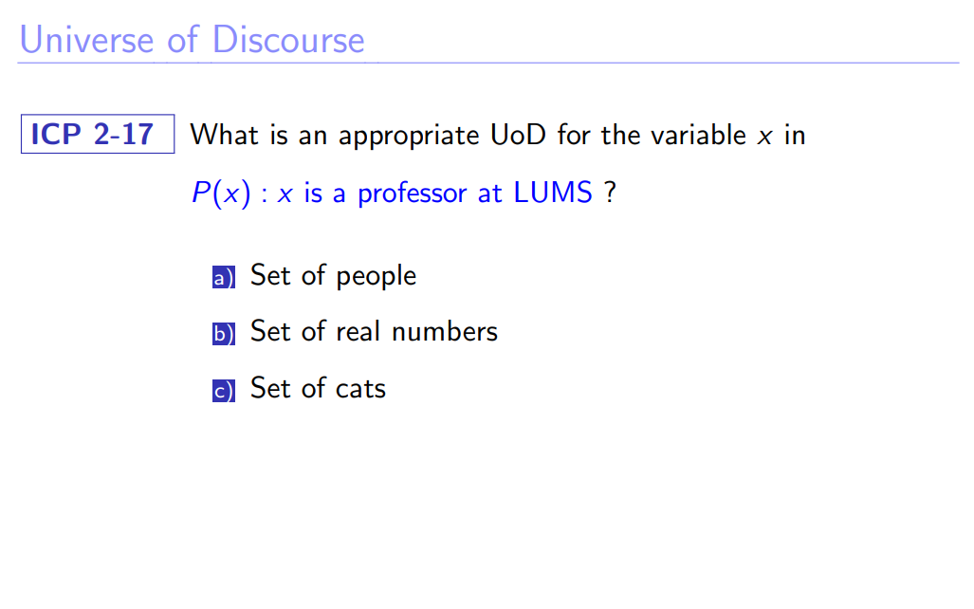

Slide 16
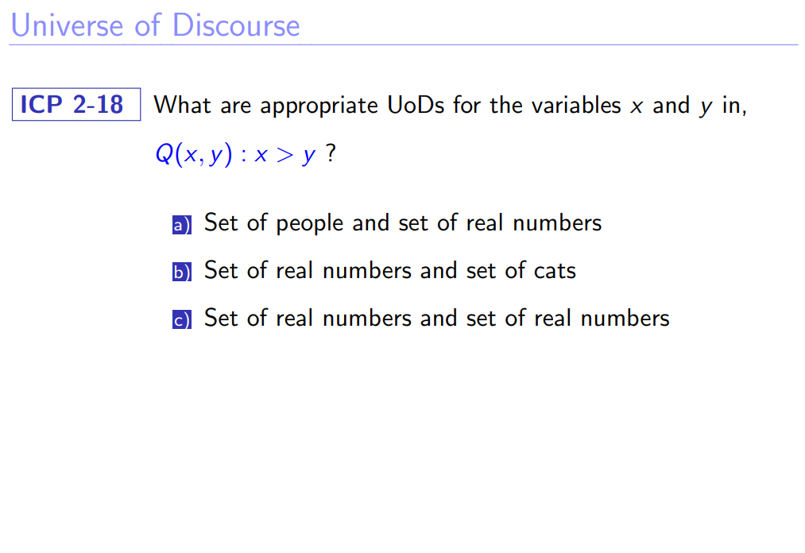

Slide 17
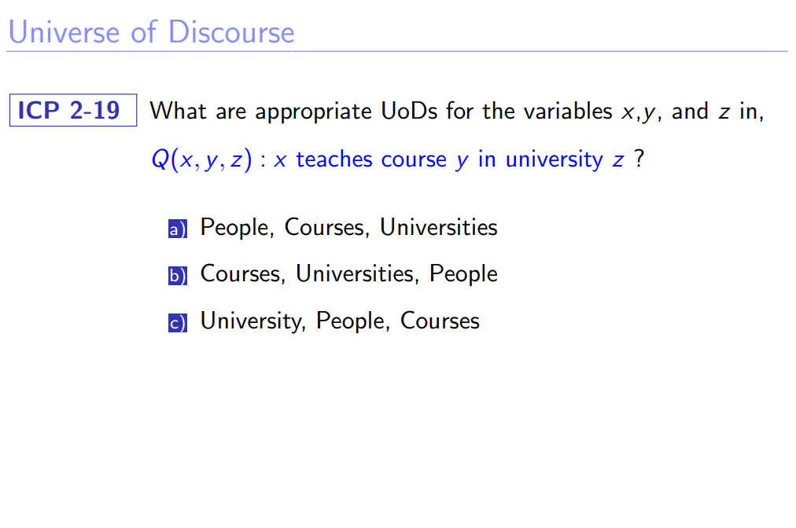

Slide 18
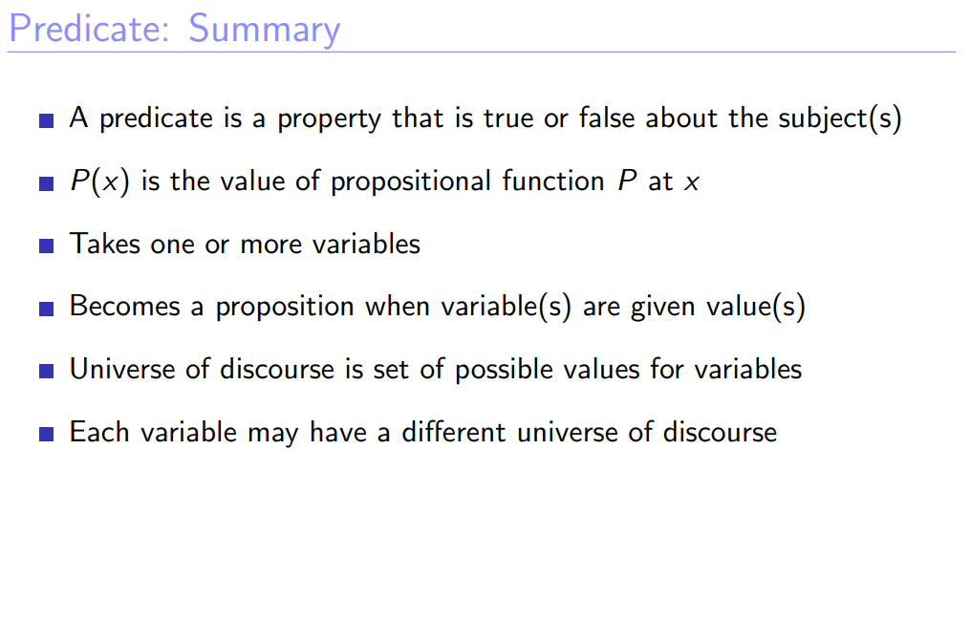

Slide 19
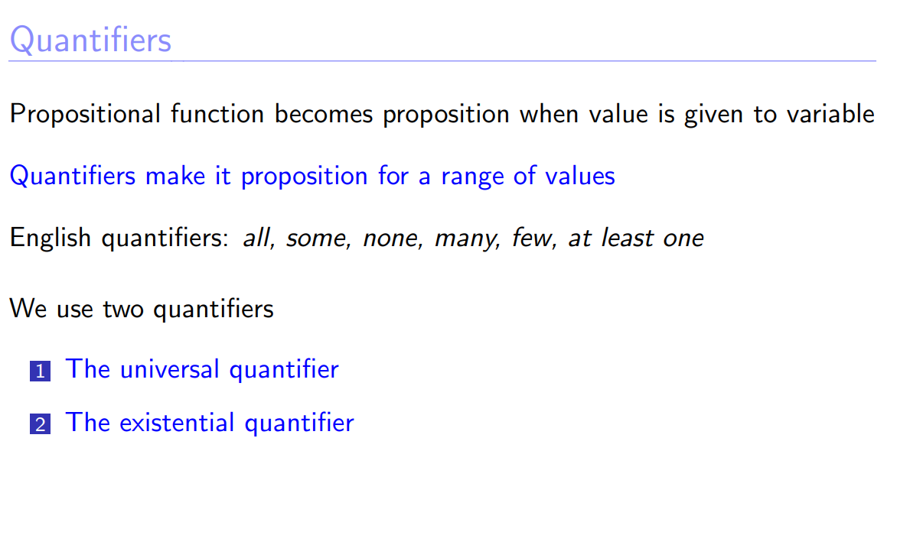

Slide 20
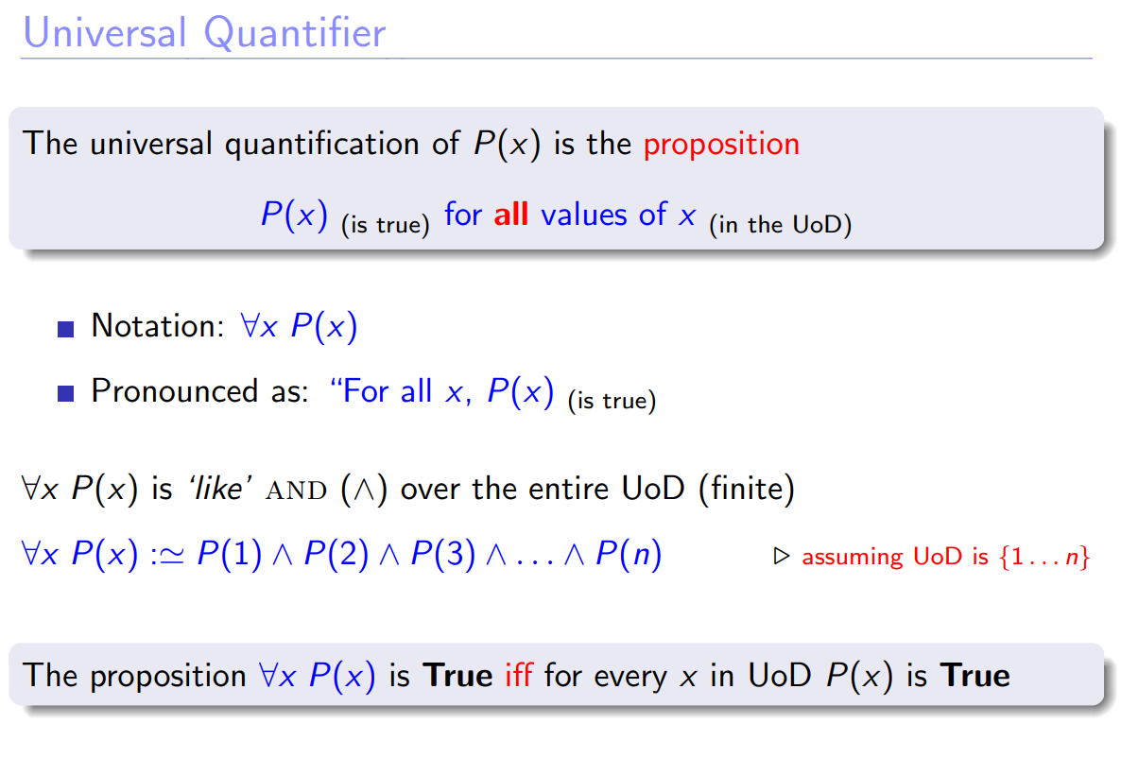

Slide 21
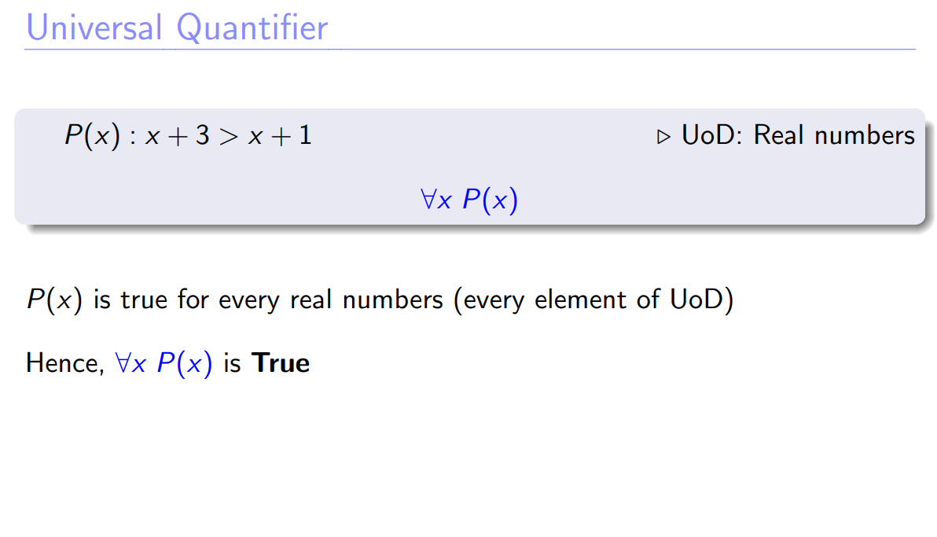

Slide 22
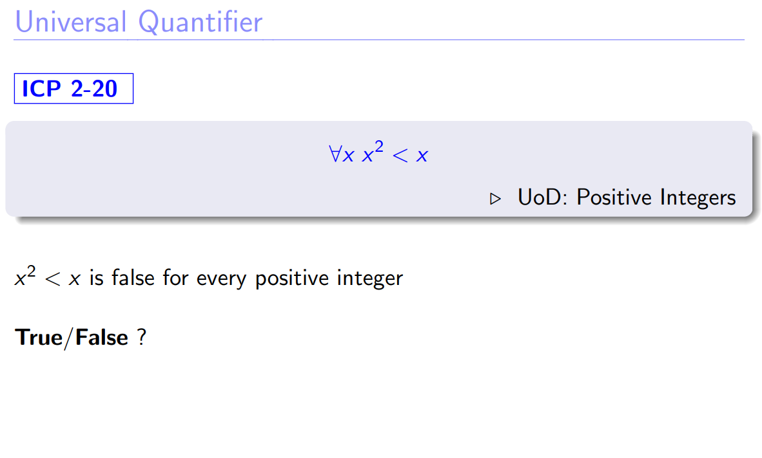

Slide 23
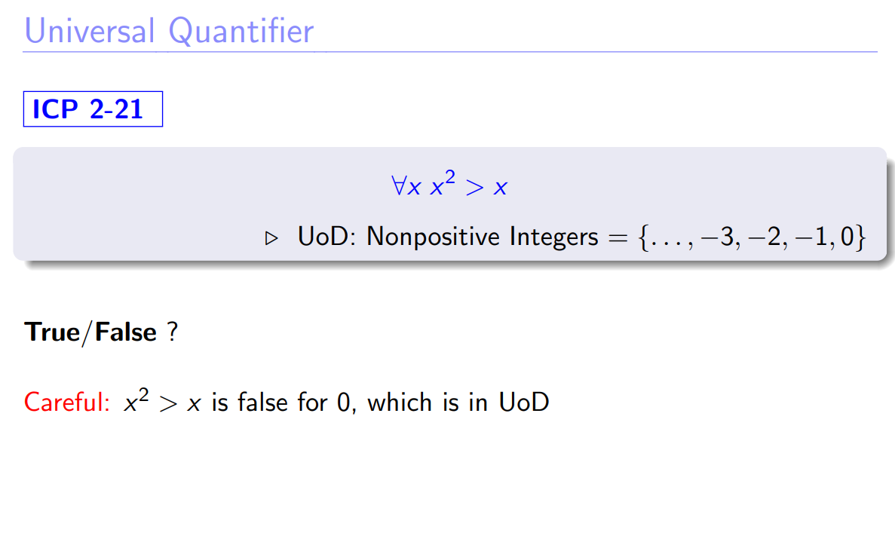

Slide 24
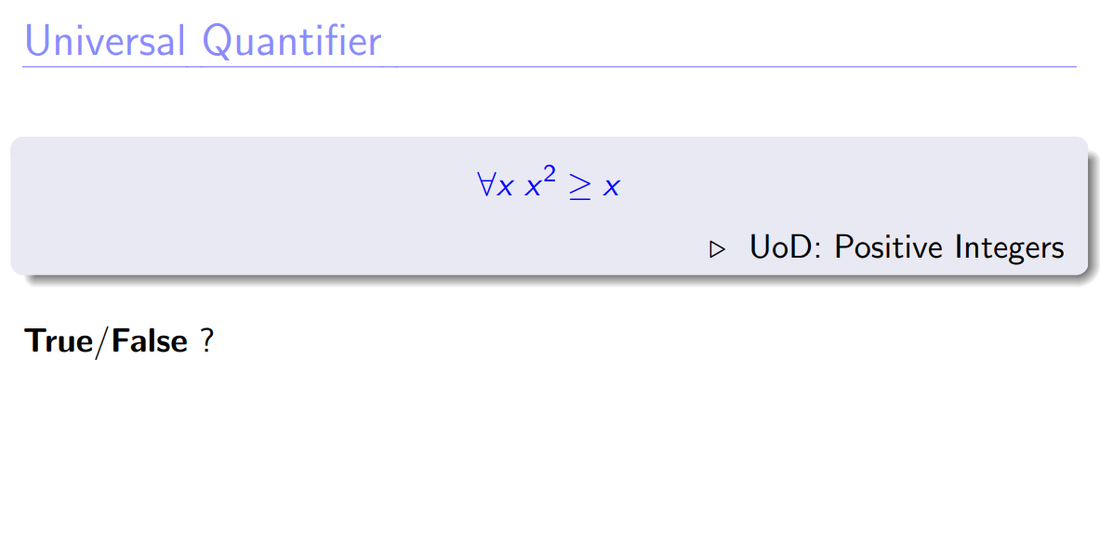

Slide 25
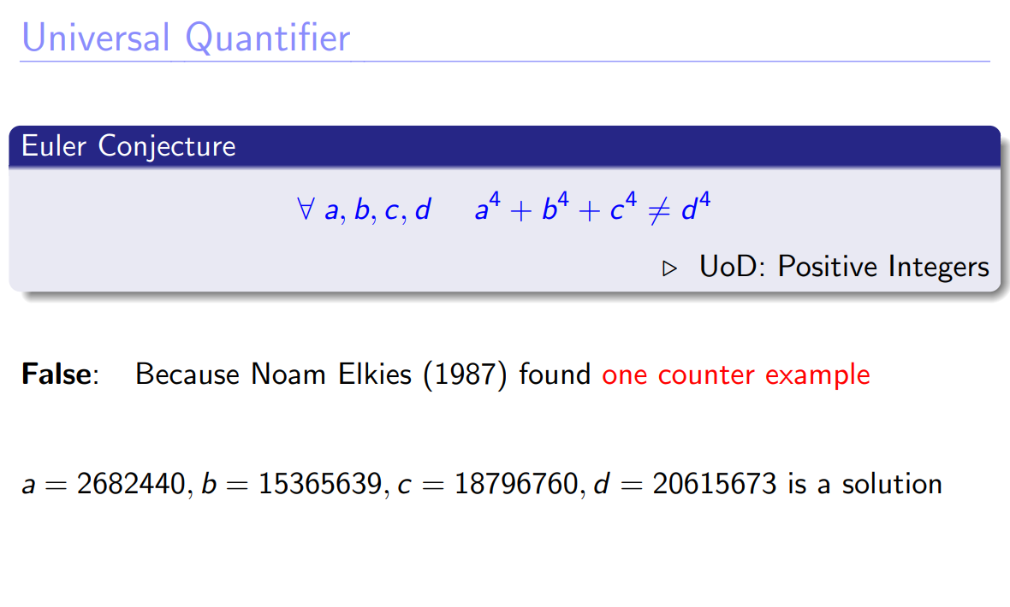
--

Slide 26
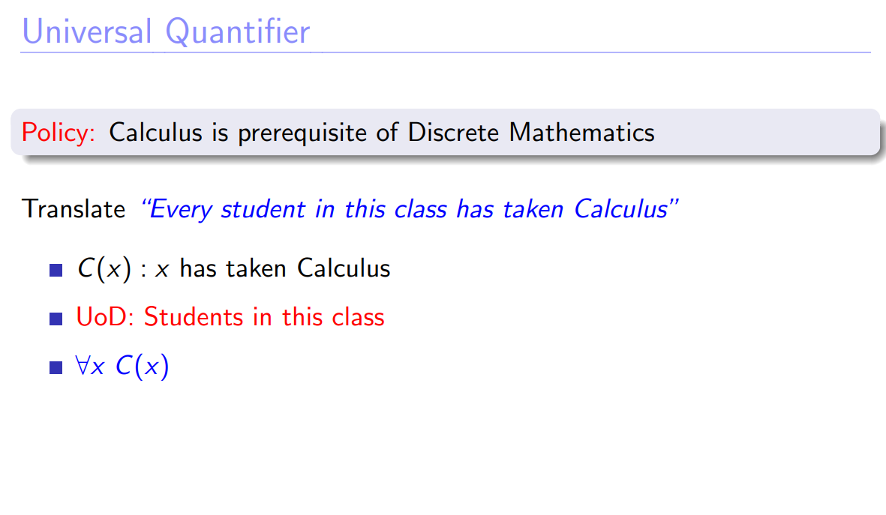

Slide 27
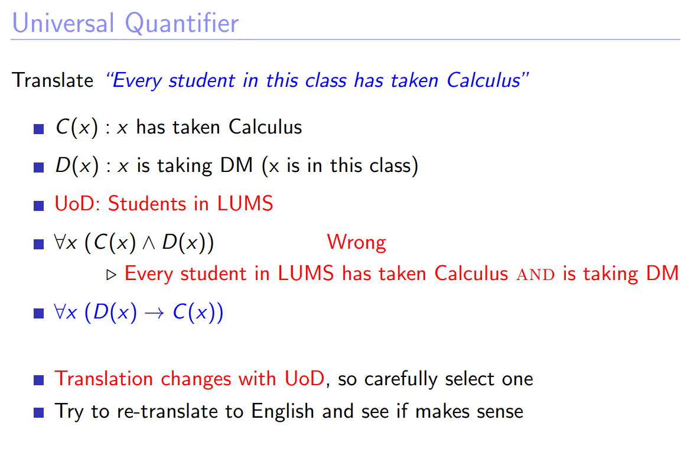

Slide 28
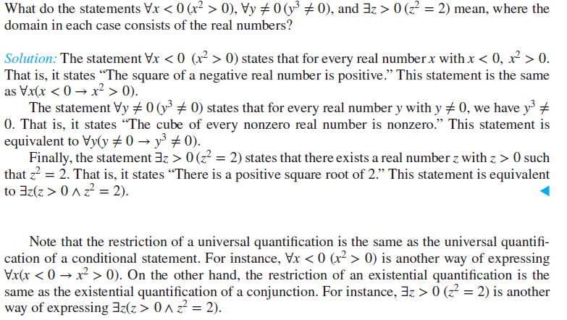
Quantifiers with Restricted Domains
An abbreviated notation is often used to restrict the domain of a quantifier. In this notation, a condition a variable must satisfy is included after the quantifier.

Slide 29
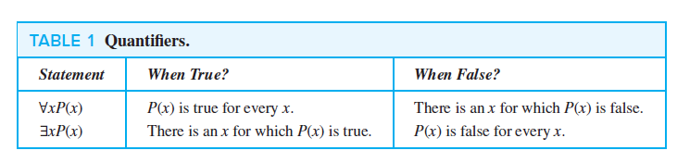

Slide 30
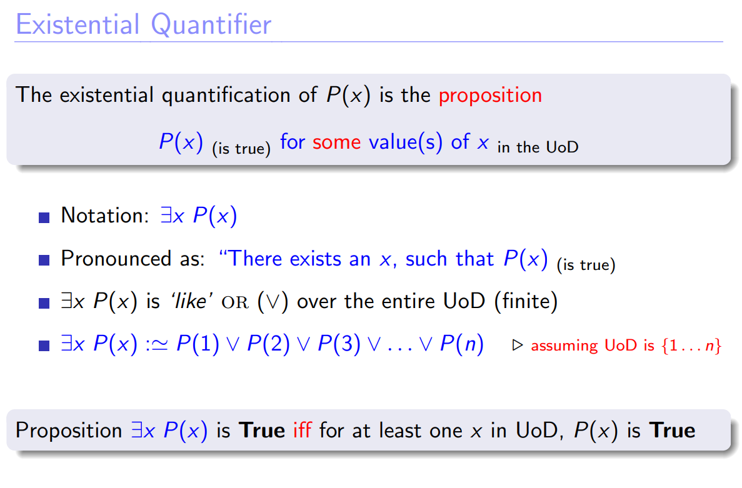

Slide 31
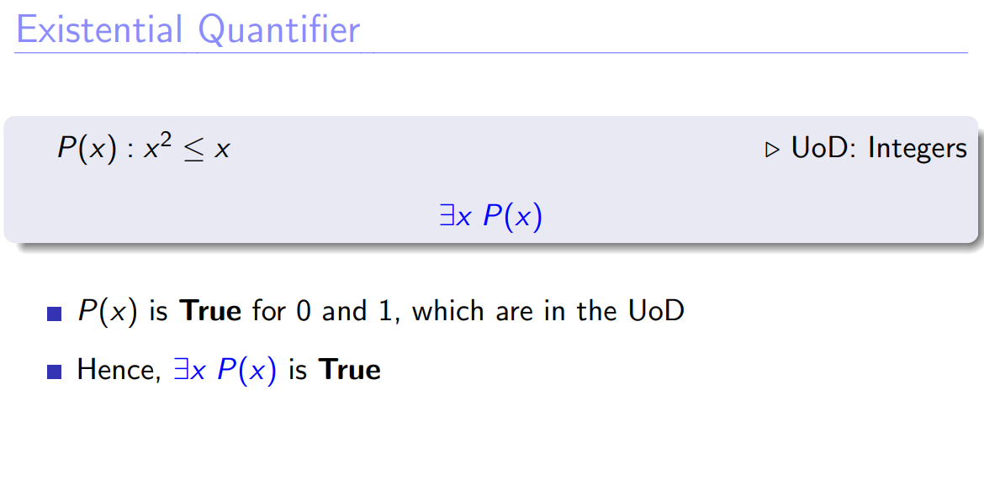

Slide 32
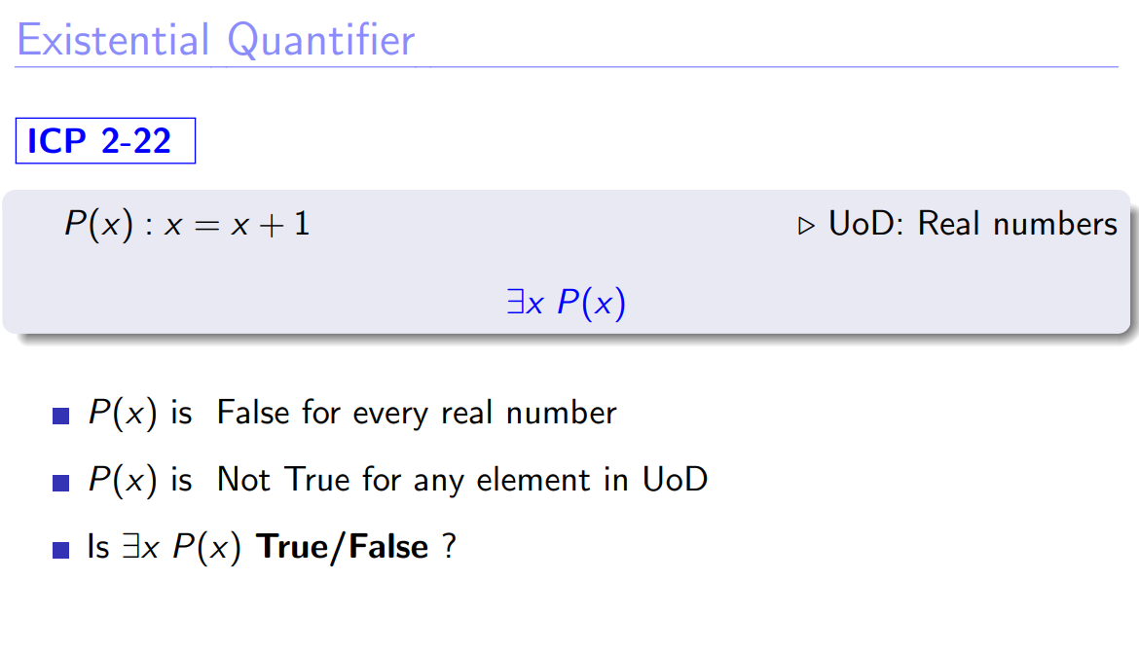

Slide 33
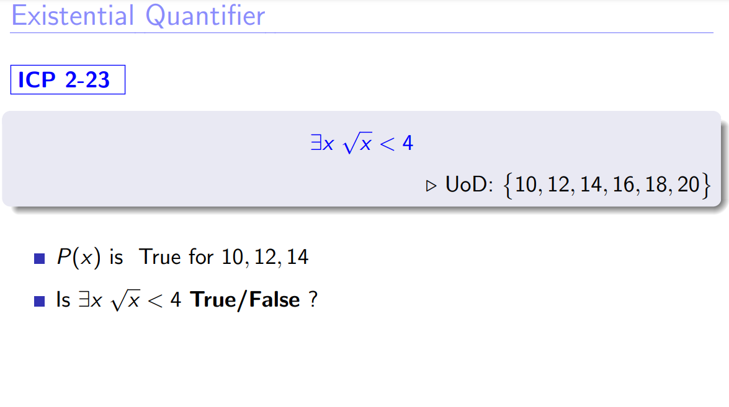

Slide 34
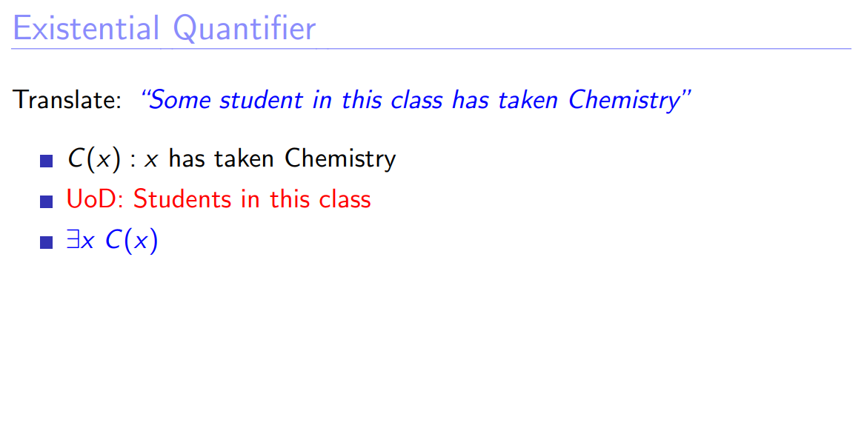

Slide 35
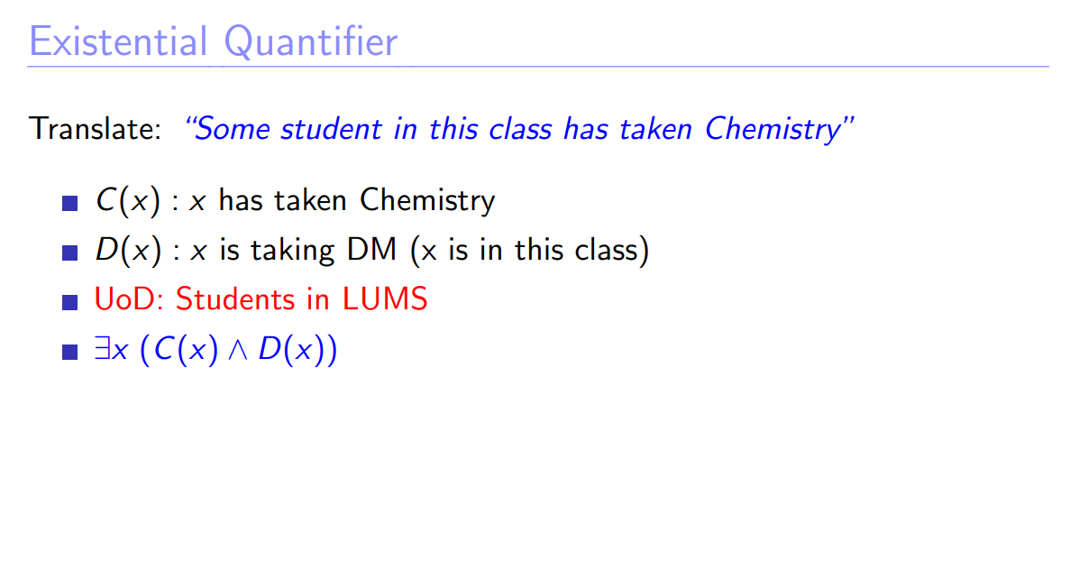

Slide 36
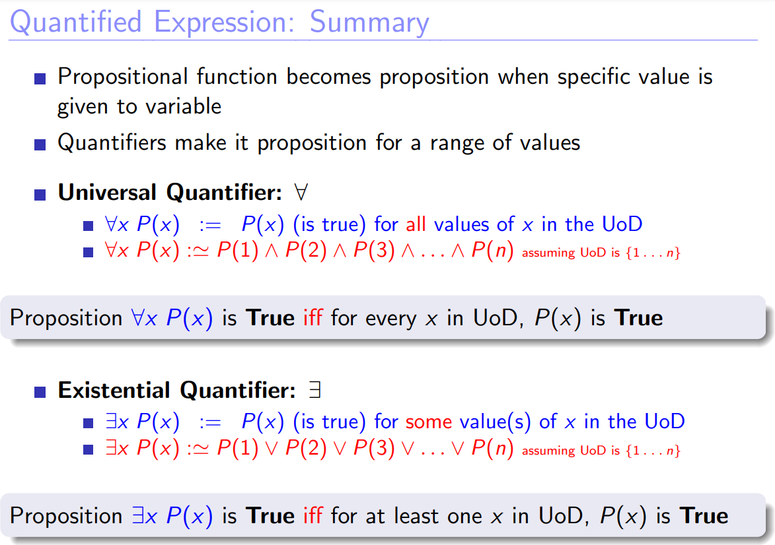

Slide 37
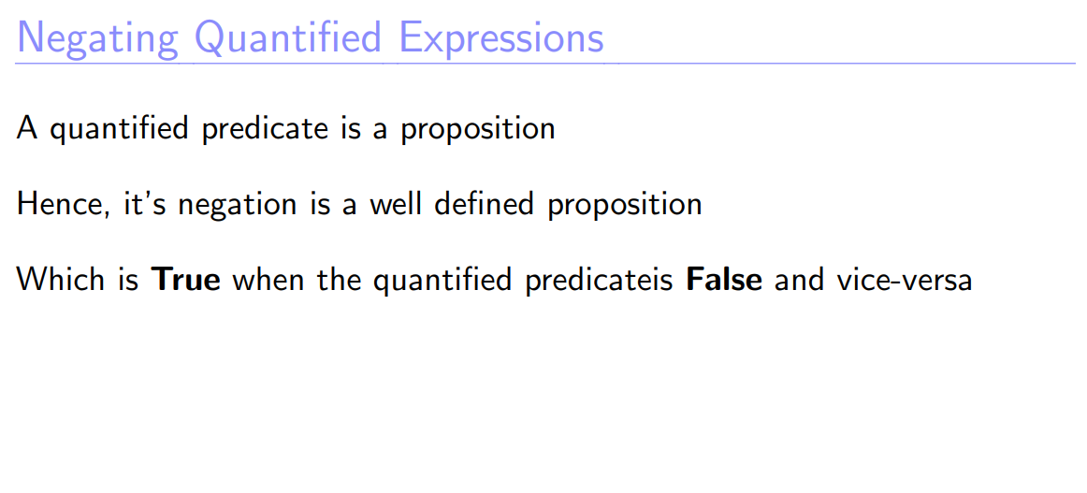

Slide 38
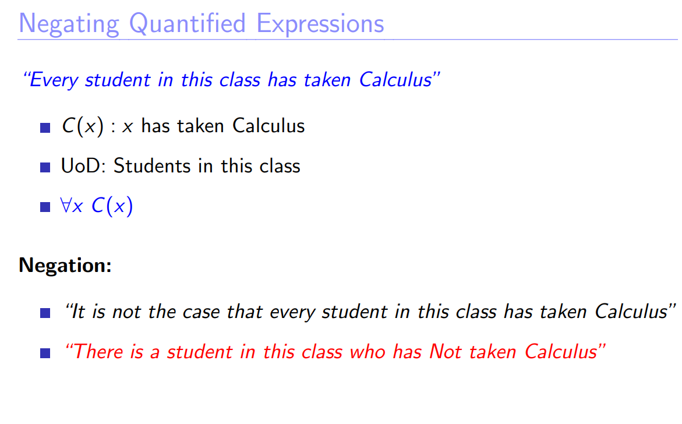

Slide 39
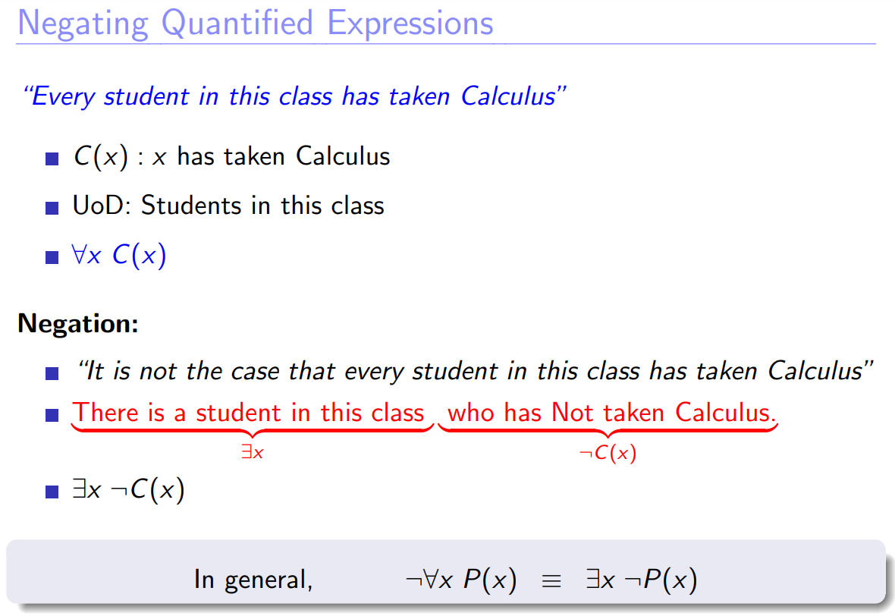

Slide 40
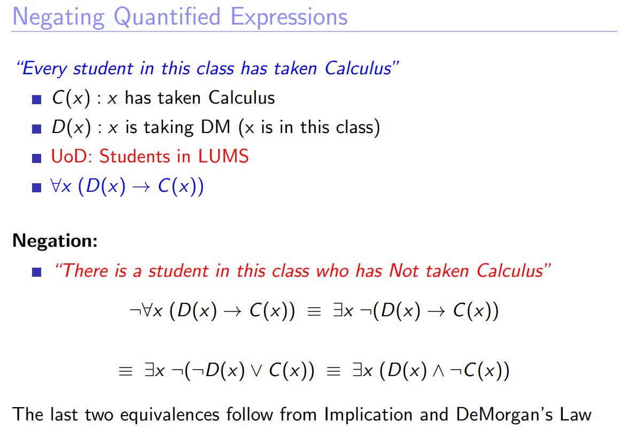

Slide 41
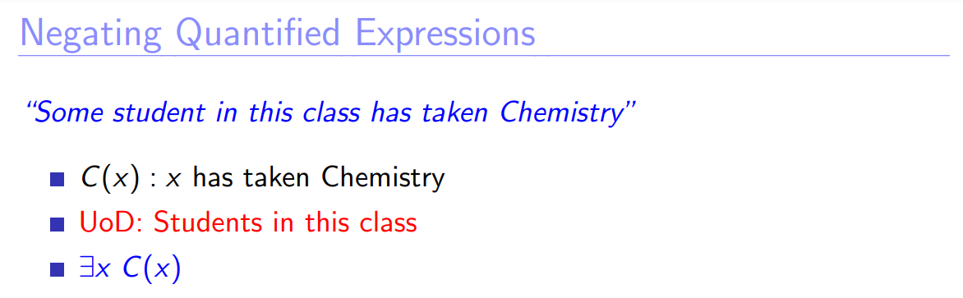
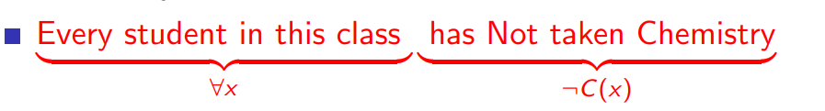

S
Negation?

Slide 42
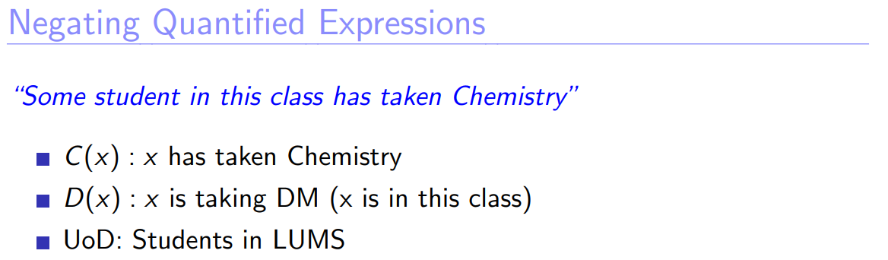
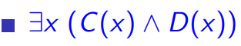
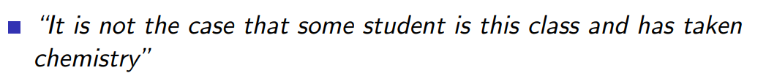
Please give the expression:
Negation?

Slide 43
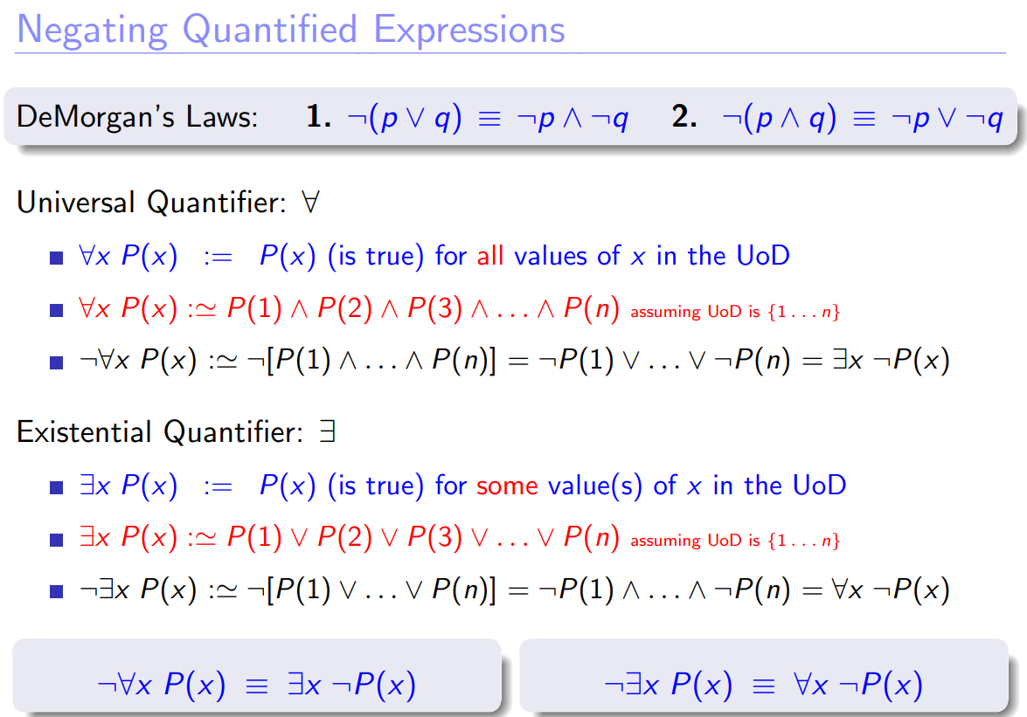

Slide 44
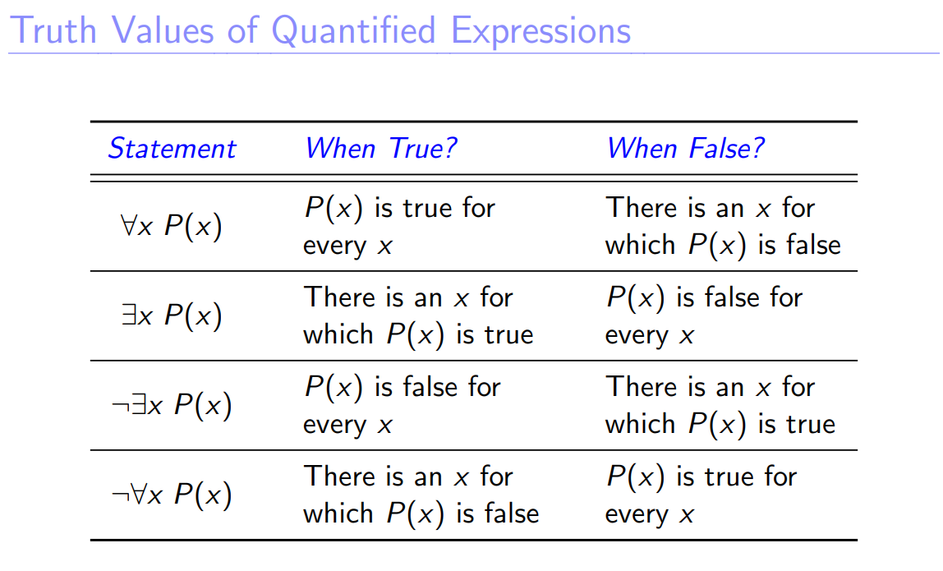

Slide 45
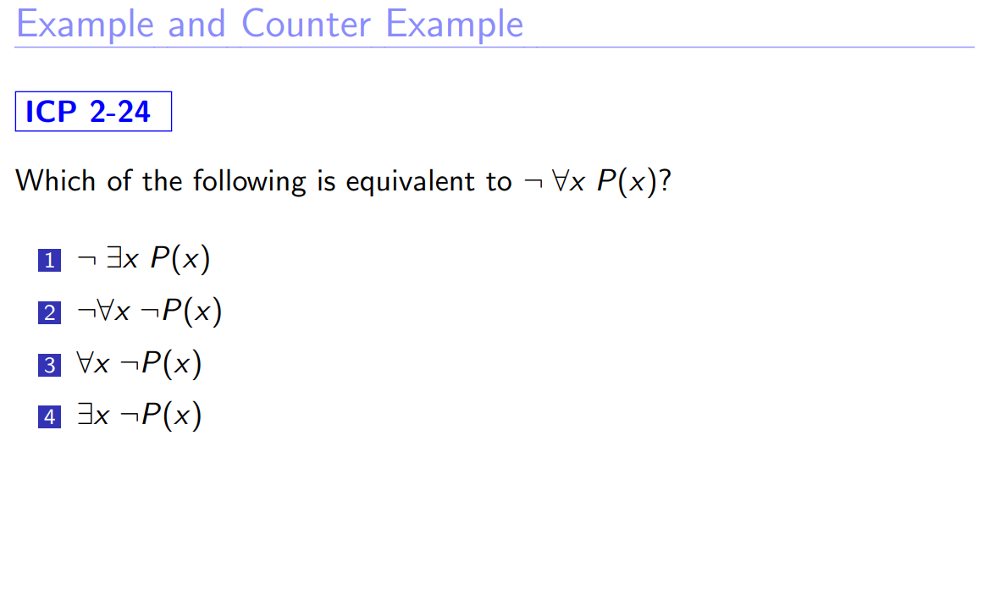

Slide 46
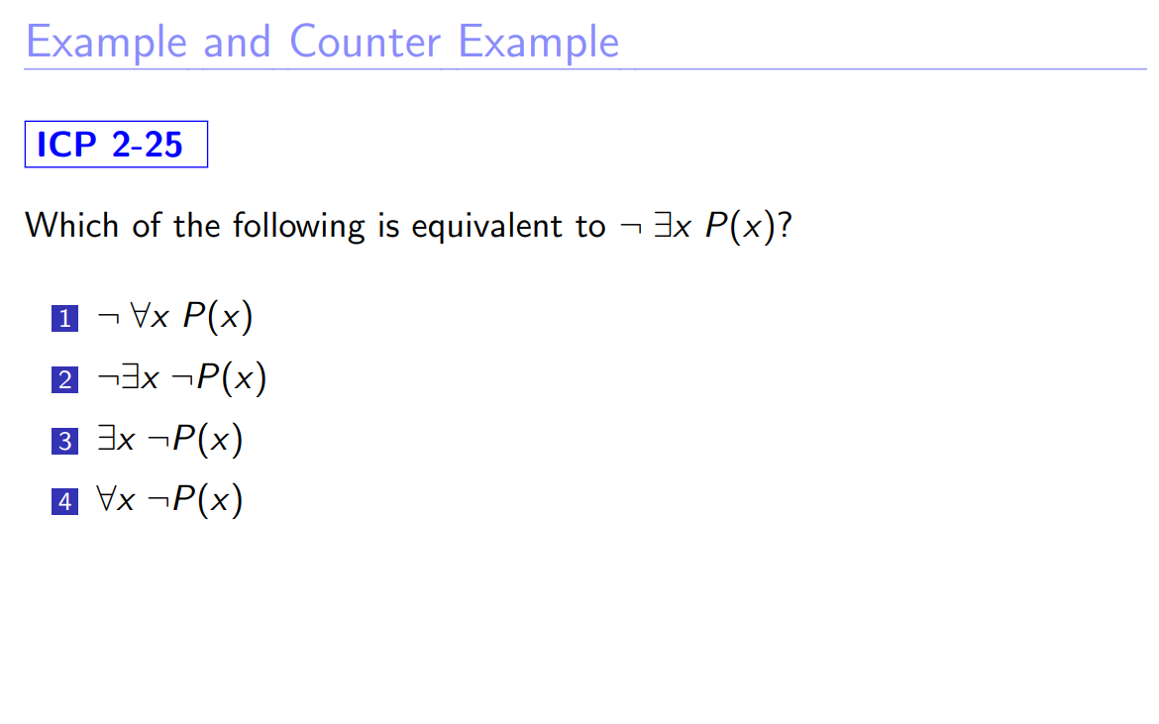

Slide 47
Negating Quantified Expressions
Perform the following tasks on the statement
All students in CS 410 are CS majors.
Negate it in English. Do not use the phrase “It is not the case that”
At least one student in CS 410 is NOT a CS major
Express it using quantifiers (define appropriate predicates and UoD)
UoD: CS410 students, C(x) : x is CS major ∀x C(x)
Negate the quantified expression, with no ¬ symbol left of a quantifier
¬∀x C(x) ≡ ∃x ¬C(x)
Translate the negation into simple English
There is a CS 410 student who is not CS major

Slide 48
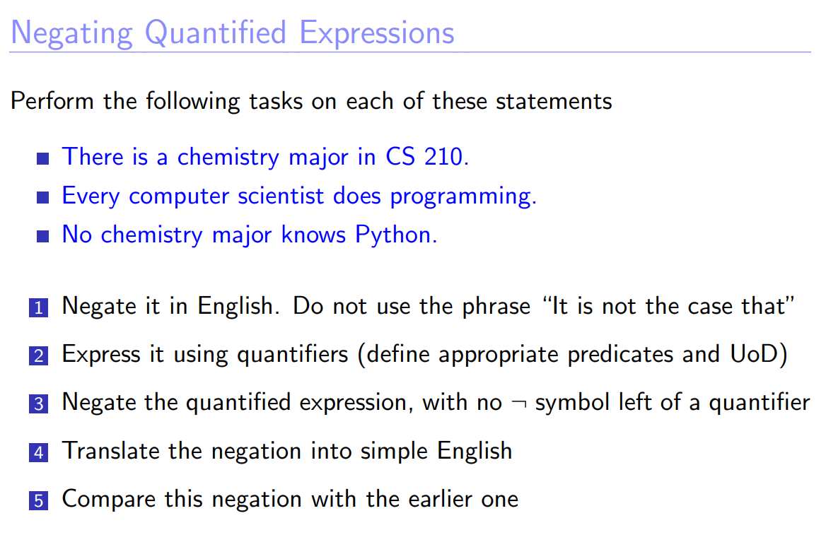

Slide 49
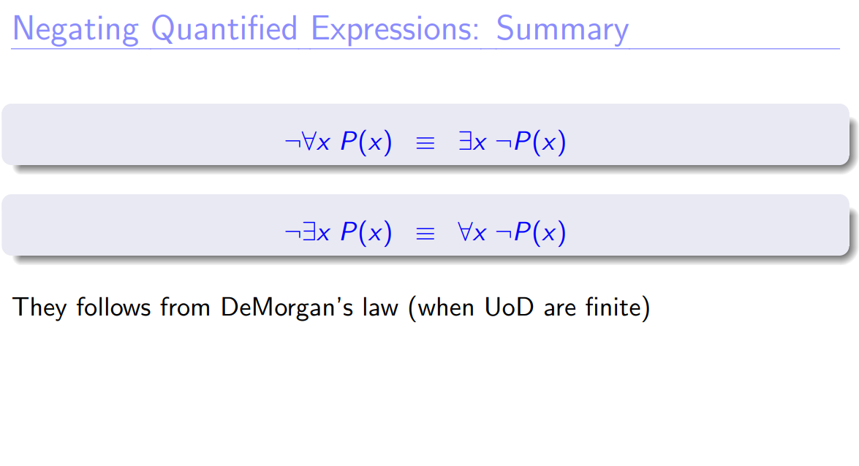

Slide 50


Slide 51


Slide 52



Slide 53


Slide 54


Slide 55


Slide 56


Slide 57


Slide 58


Slide 59


Slide 60


Slide 61


Slide 62


Source: https://math.stackexchange.com/

Slide 63

∀x∃y (x + y = 0)
Every real number has an additive inverse
∃x∀y (x + y = y)
There exists an additive identity
∀x∃y (x ̸= 0) → (xy = 1)
Every non-zero real number has a multiplicative inverse
∃x∀y (xy = y)
There exists a multiplicative identity

Slide 64


Slide 65


Slide 66


